Slide 1
My dank memes collection
LOOK CAREFULLY FOR THE password !!!
COMBINE THE 3 PARTS TO FORM THE PASSWORD.
CLUE: BEHIND EVERY GREAT MEME IS A GREAT STORY. THE SECOND PART IS “do”

Slide 2


FOLLOW YOUR DREAMS, BE DA HACKERMAN

Slide 3
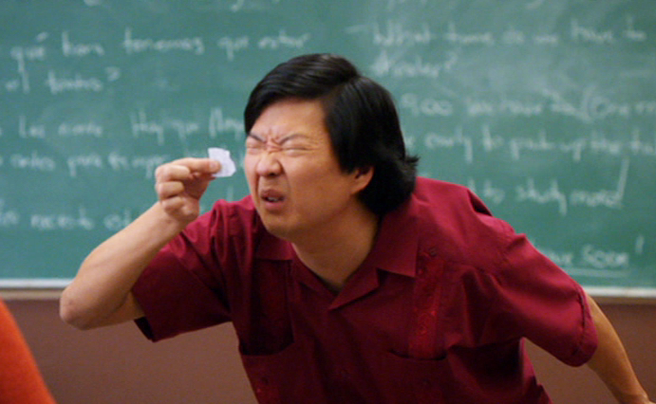

LOOKING FOR THE FLAG ? TRY HARDER
CLUE: THE LAST WORD IS “nothing”

Slide 4
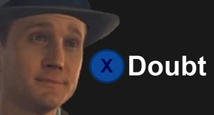
ARE YOU SURE YOU SEARCHED EVERYWHERE?

Slide 5

NO FLAG FOR YOU
CLUE: GREAT MOMENTS AWAIT AROUND EVERY CORNER. THE FIRST PART IS “just”.
Unless you ask nicely…
NOT THIS SLIDE LAH

